Slide 1
Principal Component Analysis (PCA)

Slide 2
Introduction
Principal component analysis (PCA) is a standard tool in modern data analysis - in diverse fields from neuroscience to computer graphics.
It is very useful method for extracting relevant information from confusing data sets.

Slide 3
Definition
Principal component analysis (PCA) is a statistical procedure that uses an orthogonal transformation to convert a set of observations of possibly correlated variables into a set of values of linearly uncorrelated variables called principal components.
The number of principal components is less than or equal to the number of original variables.

Slide 4
Goals
The main goal of a PCA analysis is to identify patterns in data
PCA aims to detect the correlation between variables.
It attempts to reduce the dimensionality.

Slide 5
Dimensionality Reduction
It reduces the dimensions of a d-dimensional dataset by projecting it onto a (k)-dimensional subspace (where k<d) in order to increase the computational efficiency while retaining most of the information.

Slide 6
Transformation
This transformation is defined in such a way that the first principal component has the largest possible variance and each succeeding component in turn has the next highest possible variance.

Slide 7
PCA Approach
Standardize the data.
Perform Singular Vector Decomposition to get the Eigenvectors and Eigenvalues.
Sort eigenvalues in descending order and choose the k- eigenvectors
Construct the projection matrix from the selected k- eigenvectors.
Transform the original dataset via projection matrix to obtain a k-dimensional feature subspace.

Slide 8
Limitation of PCA
The results of PCA depend on the scaling of the variables.
A scale-invariant form of PCA has been developed.

Slide 9
Applications of PCA :
Interest Rate Derivatives Portfolios
Neuroscience

Slide 10
Linear Discriminant Analysis (LDA)

Slide 11
Introduction
Linear Discriminant Analysis (LDA) is used to solve dimensionality reduction for data with higher attributes
Pre-processing step for pattern-classification and machine learning applications.
Used for feature extraction.
Linear transformation that maximize the separation between multiple classes.
“Supervised” - Prediction agent

Slide 12
Feature Subspace :
To reduce the dimensions of a d-dimensional data set by projecting it onto a (k)-dimensional subspace
(where k < d)
Feature space data is well represented?
Compute eigen vectors from dataset
Collect them in scatter matrix
Generate k-dimensional data from d-dimensional dataset.

Slide 13
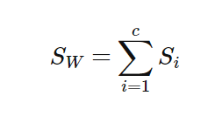
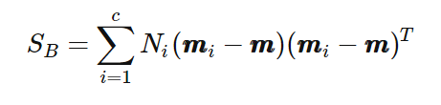
Scatter Matrix:
Within class scatter matrix
In between class scatter matrix
Maximize the between class measure & minimize the within class measure.

Slide 14
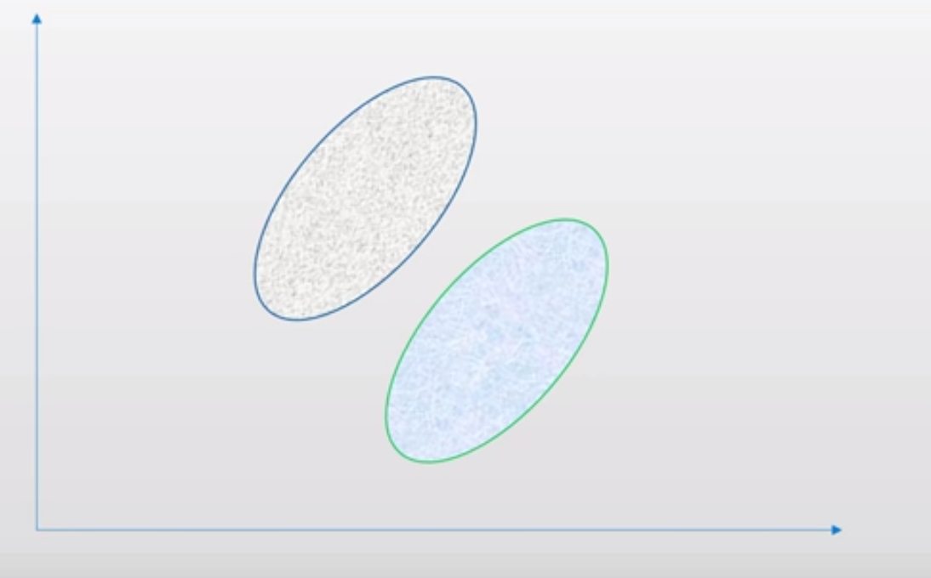

Slide 15
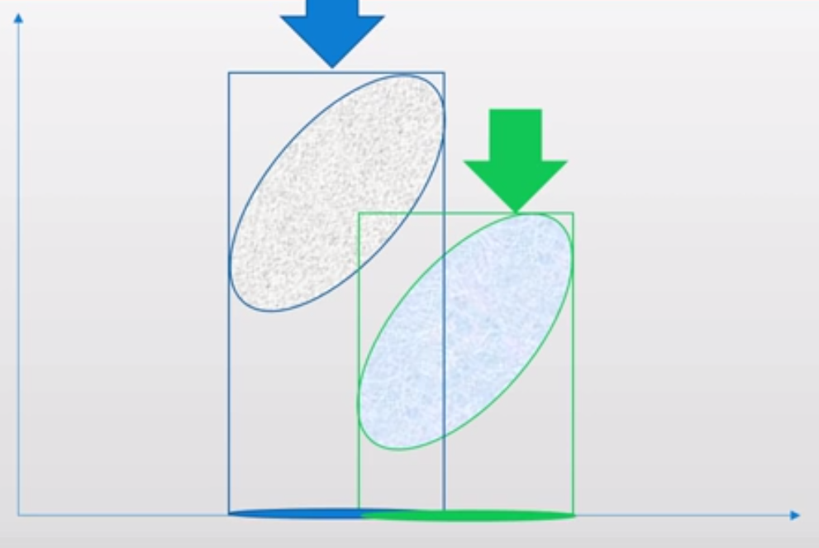

Slide 16
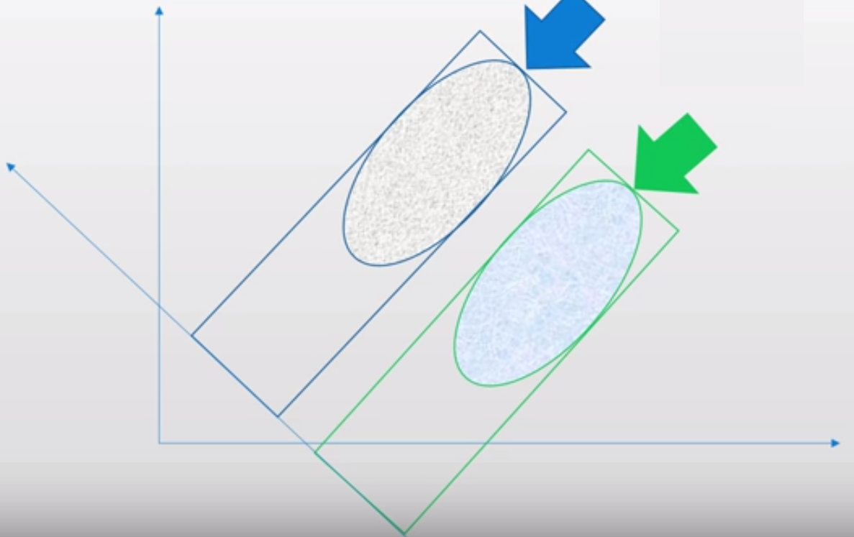

Slide 17
LDA steps:
Compute the d-dimensional mean vectors.
Compute the scatter matrices
Compute the eigenvectors and corresponding eigenvalues for the scatter matrices.
Sort the eigenvalues and choose those with the largest eigenvalues to form a d×k dimensional matrix
Transform the samples onto the new subspace.

Slide 18
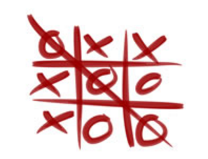
Dataset
Attributes :
X
O
Blank
Class:
Positive(Win for X)
Negative(Win for O)

Slide 19
Dataset
top-left-square | top-middle-square | top-right-square | middle-left-square | middle-middle-square | middle-right-square | bottom-left-square | bottom-middle-square | bottom-right-square | Class
x | x | x | x | o | o | x | o | o | positive
x | x | x | x | o | o | o | x | o | positive
x | x | x | x | o | o | o | o | x | positive
o | x | x | b | o | x | x | o | o | negative
o | x | x | b | o | x | o | x | o | negative
o | x | x | b | o | x | b | b | o | negative

Slide 20
References:
[1]https://en.wikipedia.org/wiki/Principal_component_analysis#
[2]http://sebastianraschka.com/Articles/2015_pca_in_3_steps.html#a-summary-of-the-pca-approach
[3]http://cs.fit.edu/~dmitra/ArtInt/ProjectPapers/PcaTutorial.pdf
[4] Sebastian Raschka, Linear Discriminant Analysis Bit by Bit, http://sebastianraschka.com/Articles/414_python_lda.html , 414.
[5] Zhihua Qiao, Lan Zhou and Jianhua Z. Huang, Effective Linear Discriminant Analysis for High Dimensional, Low Sample Size Data
[6] Tic Tac Toe Dataset - https://archive.ics.uci.edu/ml/datasets/Tic-Tac-Toe+Endgame

